Slide 1

TRAGEDY OF FLIGHT
A COMPREHENSIVE CRASH ANALYSIS

Slide 2
Airplane crashes are devastating events that can have significant impacts on the aviation industry, passengers and their families, and the broader community. Analyzing airplane crashes is critical to understanding their causes, preventing future incidents, and improving aviation safety.

Slide 3

EMPATHY MAP

Slide 4
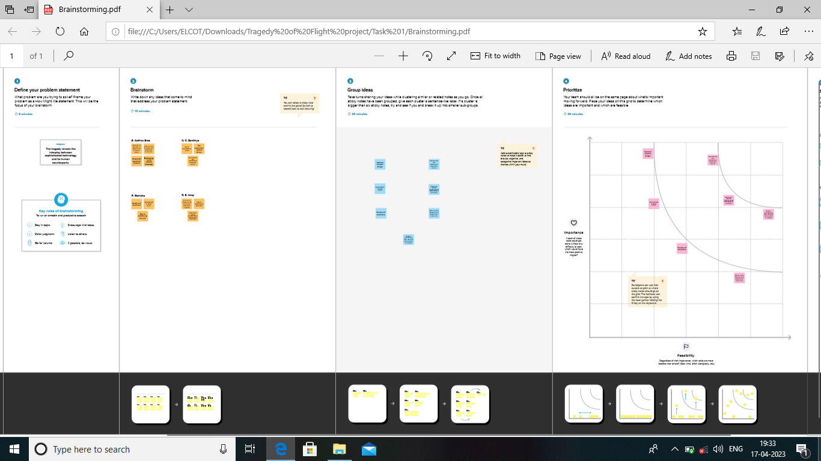
BRAINSTORMING MAP

Slide 5
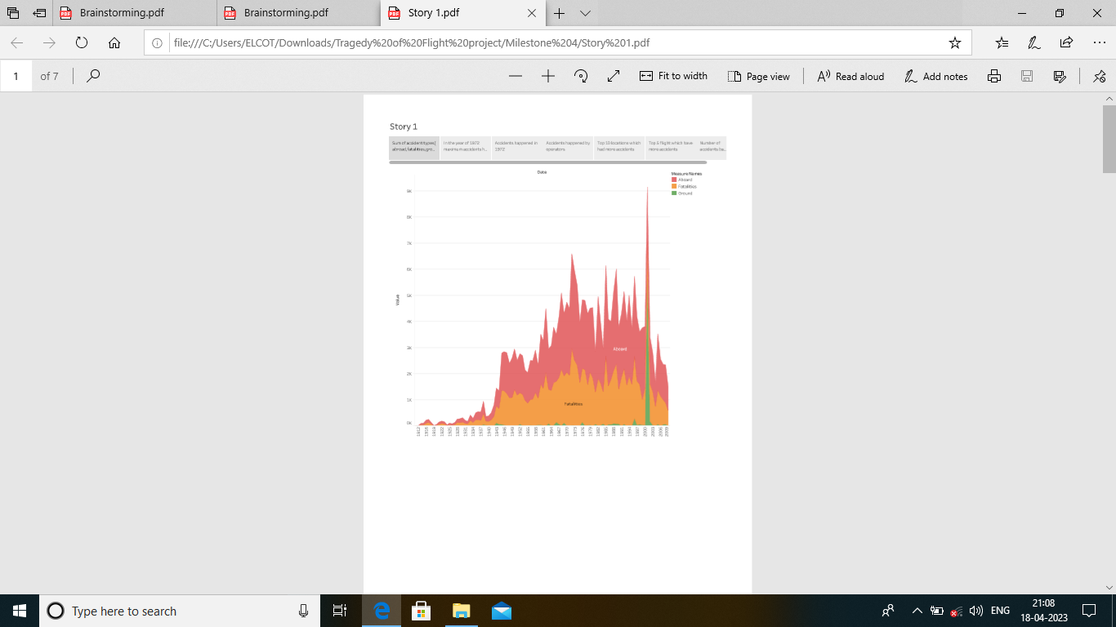
COMPARING ABROAD VS FATALITIES VS GROUND

Slide 6
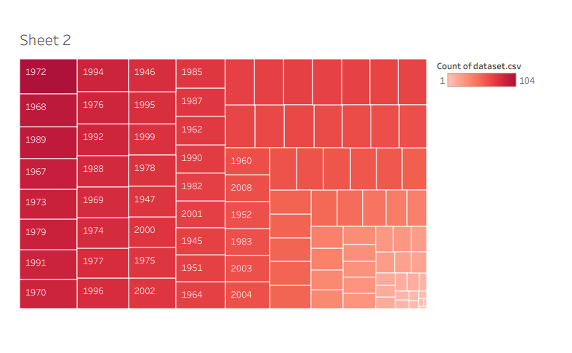
MAXIMUM ACCIDENTS BASED ON YEARS

Slide 7
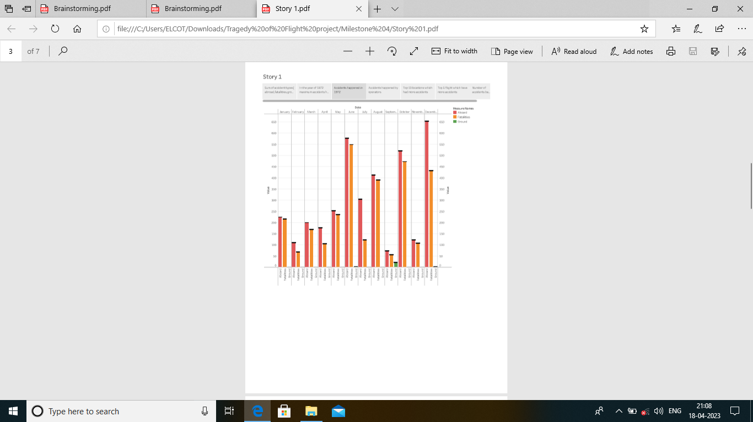
ACCIDENTS HAPPENED IN 1972 BASED ON MONTHS

Slide 8
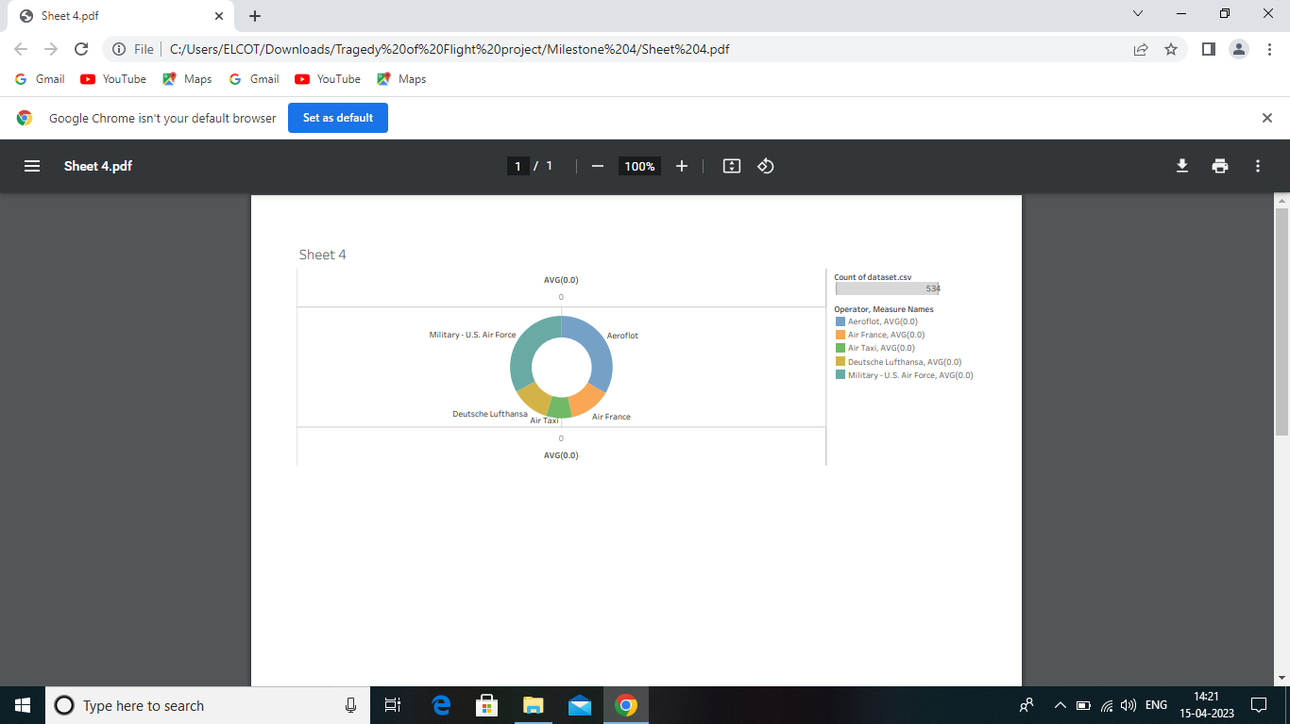
HIGHEST NO. OF ACCIDENT HAPPENED BY OPERATORS

Slide 9
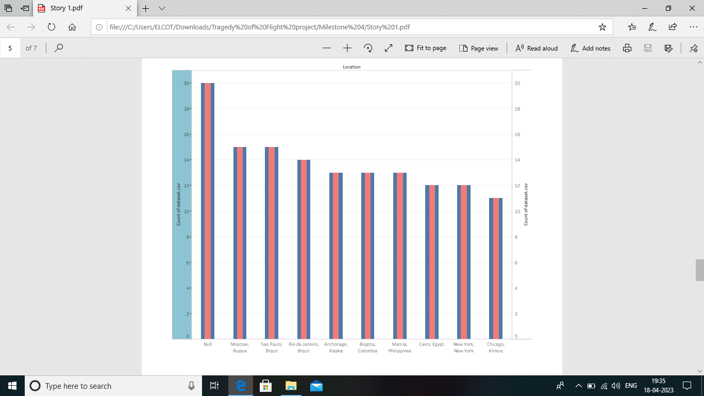
TOP 10 LOCATIONS WHICH HAD MORE ACCIDENTS

Slide 10
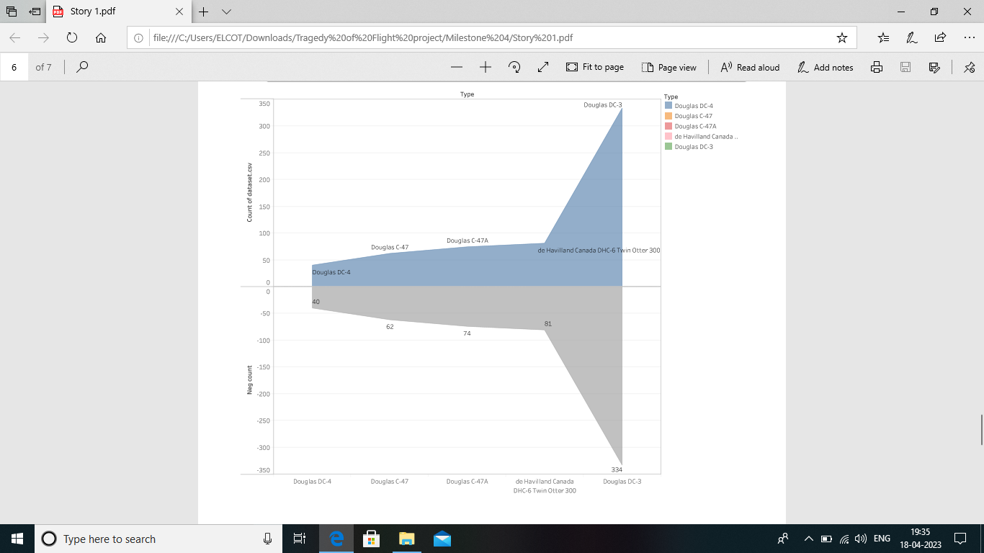
TOP 3 FLIGHTS WHICH MAX. ACCIDENTS HISTORY

Slide 11
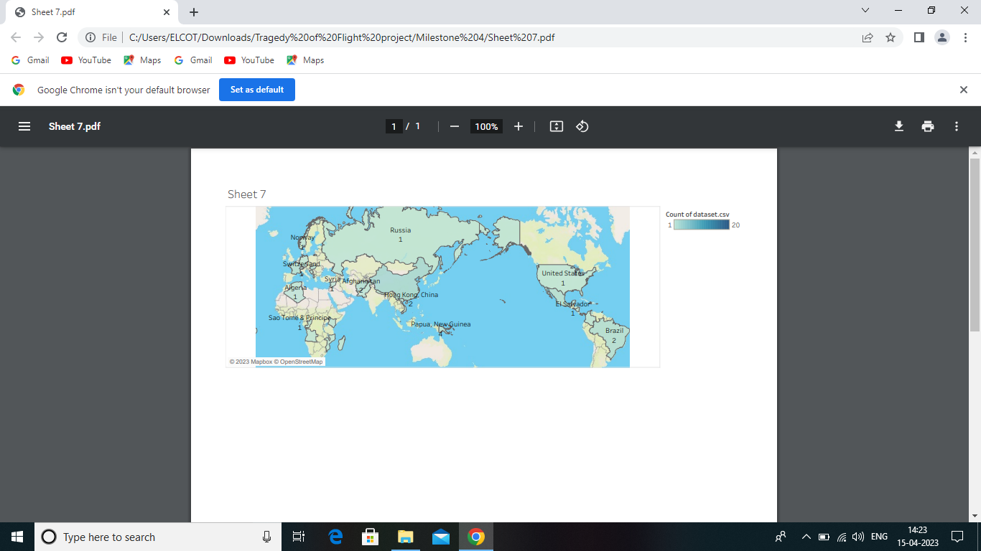
ACCIDENTS BASED ON REGIONS

Slide 12
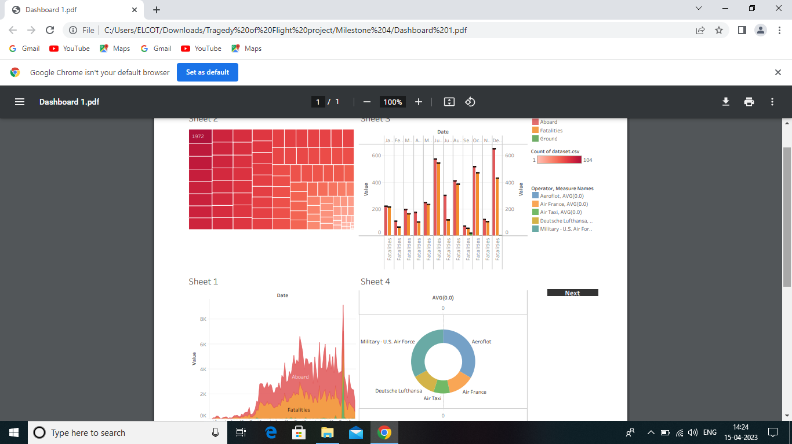
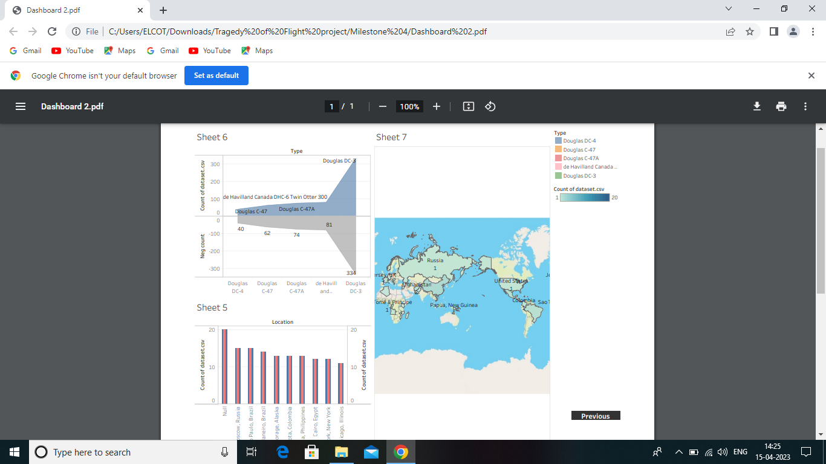
DASHBOARD
1
2

Slide 13
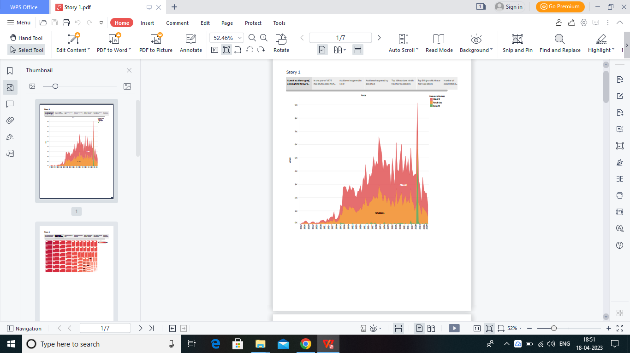
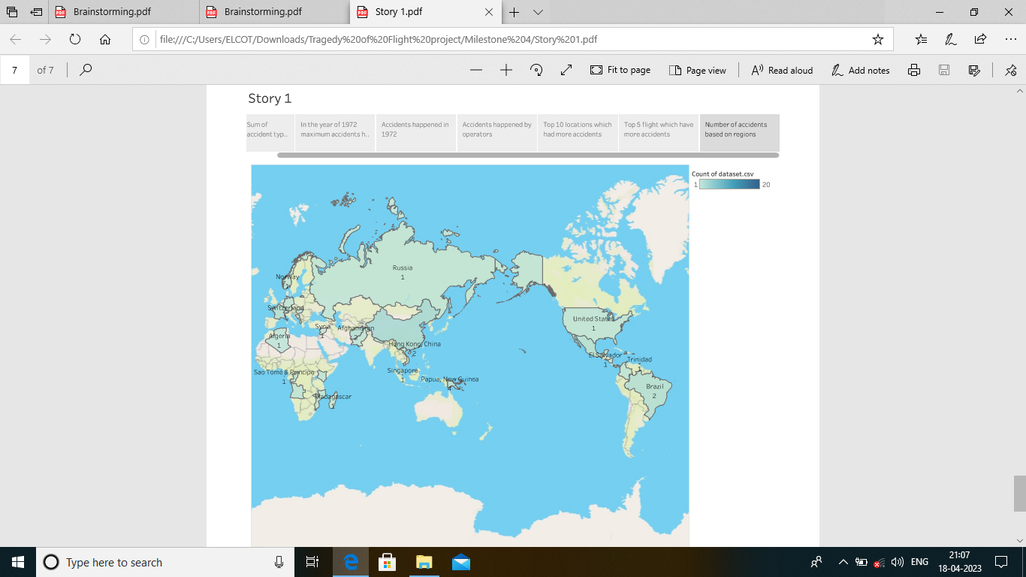
STORY
1
2

Slide 14
SUBMITTED BY, S. Aathira sree K. C. Santhiya R. Genisha R. E. Ancy

